Slide 1

Vaccine Hesitancy
Stanley A. Plotkin
Russia 4-9 2015
5/13/2015 12:32 PM

Slide 2
Vaccines for Children and Adolescents
Now Routinely Given in
Different Parts of the World
Diphtheria | Measles
Tetanus | Mumps
Pertussis | Rubella
Polio | Varicella
Hepatitis B | Pneumococcus
Hemophilus influenzae | Human Papillomavirus
Rotavirus | Meningococcus A, C, W, Y
Hepatitis A | Influenza
Japanese Encephalitis | Tick-Borne Encephalitis

Slide 3
“The impact of vaccination on the health
of the world’s peoples is hard to exaggerate.
With the exception of safe water, no other
modality has had such a major effect on
mortality reduction and population growth.”
Susan and Stanley Plotkin, A Short History of Vaccination, in Vaccines 1st Edition, 1988

Slide 4
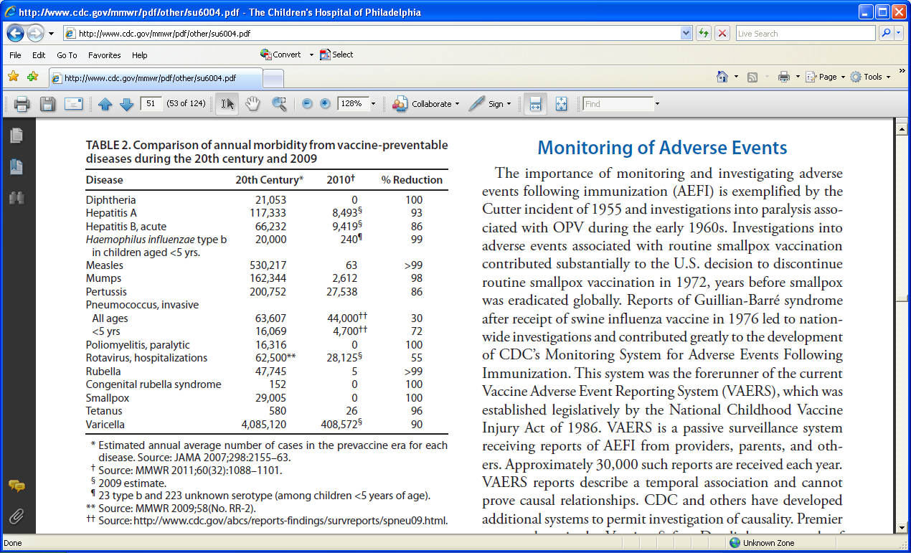
Impact of Vaccines
MMWR / October 7, 2011 / Vol. 60

Slide 5
Status of Rubella and in the Context
of Measles-Rubella Vaccination
Elimination Achieved:
Scandinavia
USA, Canada
Caribbean
Latin America
Elimination set as goal:
Western Europe
Control Starting:
Eastern Europe
Middle East
Japan, Malaysia, Korea, Thailand, India

Slide 6
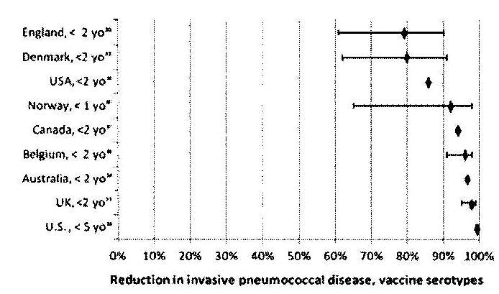
Impact of PCV7 on
Invasive Pneumococcal Disease
̶ Vaccine Serotypes
Fitzwater SP, et cl. PIDJ 31(5):501-8, 2012

Slide 7
Efficacy of HPV Quadrivalent Vaccine
in Females 16-26 Years
HPV 6, 11, 16, 18 | Cervical Neoplasia | 96%
HPV 6, 11, 16, 18 | Genital Warts | 99%
HPV 16, 18 | Vulval neoplasia | 98%
HPV 16, 18 | Vaginal neoplasia | 100%

Slide 8
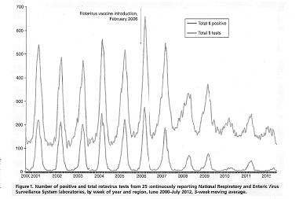
Effect of Rotavirus Vaccine in the United States
Rha B, et al. Exp. Rev. Vaccines 13(3):365-376 (2014)

Slide 9
Efficacy of RotaTeq® Against Hospitalizations and Emergency Department Visits for G1-4RV AGE by Region
 | Number of Cases |  | %
Region | Vaccine | Placebo | Rate Reduction | 95% CI
Europe | 16 | 301 | 95 | 91, 97
US | 1 | 27 | 96 | 77, 100
Native Am. Nations | 2 | 31 | 93 | 76,99
Latin Am. Caribbean | 1 | 10 | 90 | 29, 100
9

Slide 10
A consequence of success
Vaccine Hesitancy
Concerns about disease risk
Concerns about vaccine safety
Low perceived risk of VPD’s and underappreciation of transmission risks
Underappreciation of disease severity
Easy access to misinformation → persistent vaccine safety concerns
Notes:
Consequence of this success is less experience with many vaccine preventable disease- no longer perceived as a threat- therefore makes concerns regarding vaccine safety more prominent

Slide 11
Vaccine Hesitancy is Widespread
Its major causes are:
Disinformation on internet
Inability to evaluate risk of disease versus
risk of vaccine reaction
Inadequate education of physicians and nurses
Disappearance of disease due to vaccination
Lack of altruism

Slide 12
Vaccine hesitancy is a behavior influenced by a number of factors including issues of confidence, complacency, and convenience. Vaccine-hesitant individuals are a heterogeneous group who hold varying degrees of indecision about specific vaccines or vaccination in general. Vaccine hesitant individuals may accept all vaccines but remain concerned about vaccines; some may refuse or delay some vaccines, but accept others; some individuals may refuse all vaccines.

Slide 13
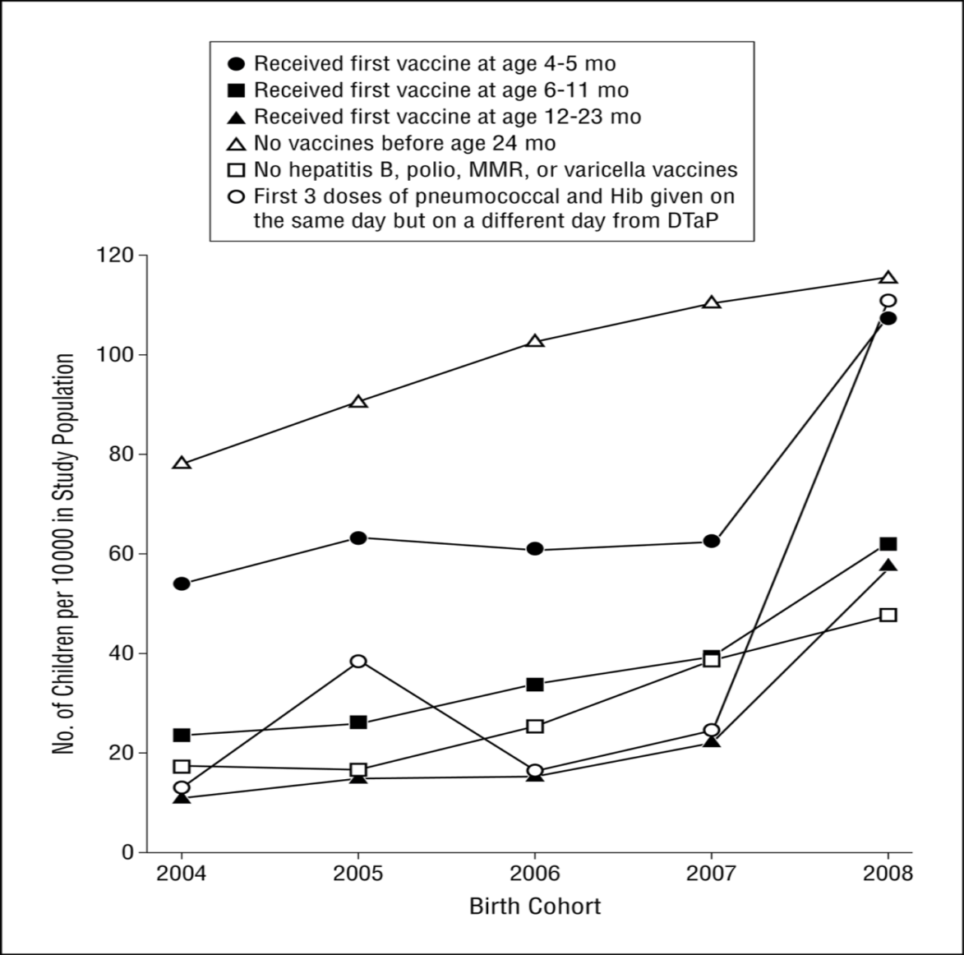
Vaccine Refusal
Majority of physicians report >1 vaccine refusal / month
13% children under-vaccinated due to parental choice
Growing number of pediatricians accept requests for delay (13 → 37%)
Glanz JM JAMA Pediatr. 2013;167(3):274-281; Gowda, etal. Hum Vac Imm, 2013.

Slide 14
A consequence of success and changing times
Distrust and scientific denialism
Rapid dissemination of misinformation
Naturalism
Distortion of risk
Changes in Decision-making

Slide 15
Vaccine and vaccination-specific issues
Risk/benefit (scientifically based)
Vaccination schedule
Mode of administration
Mode of delivery
Introduction of a new vaccine or new formulation
Reliability of vaccine supply
Role of healthcare professionals
Costs
Tailoring vaccines/ vaccination to needs

Slide 16
Contextual Influences:
Influential leaders and individuals
Politics/ policies (eg. Mandates)
Religion / Culture / Gender
Socio-economic group
Communication and media environment
Historical influences

Slide 17
Individual/social group influences
Immunization is a social norm vs. immunization is not
needed/harmful
Beliefs, attitudes and motivation about health and prevention
Knowledge/awareness of why/where/what/when vaccines
are needed
Personal experience with and trust in health system and
provider
Experience with past vaccination

Slide 18
Communication: Is Providing Information Effective?
Different types of information about measles did not change beliefs about MMR and side effects or vaccines and autism
  Parents who received a narrative about measles disease were more likely to report belief that MMR causes significant side effects
Effects of Interventions on MMR Misperceptions
 | Vaccines cause Autism | MMR Side Effects
Autism correction | 0.55 (0.38-0.79) | 0.81 (0.57-1.15)
Disease risks | 1.15 (0.79-1.67) | 0.93 (0.65-1.35)
Disease narrative | 1.47 (1.02-2.13) | 1.18 (0.82-1.69)
Somewhat favorable toward vaccines (baseline: least favorable) | 0.22 (0.16-0.30) | 0.49 (0.37-0.6)
Most favorable toward vaccines (baseline: least favorable) | 0.06 (0.04-0.08) | 0.23 (0.17 – 0.31)
N | 1736 | 1746
Nyhan B, etal. Pediatrics 2014
Notes:
47% of parents with initial resistance accepted vaccination when providers pursued their initial recommendation

Slide 19
Many Physicians are Uneducated
about Vaccines
Don’t know:
  Real incidence of reactions
  Real data on efficacy
  Importance of herd immunity
Medical schools don’t spend enough
time on vaccines

Slide 20
Provider recommendation matters
Be proactive
Know the disease
Find a common ground
Use numbers to communicate risk and provide perspective
Talk about risk associated with other daily activities to provide context
Use personal stories
Know the vaccine- acknowledge known side effects but also emphasize evidence supporting safety and benefit
Know about additional resources
Make recommendation strong
Healy CM, etal Pediatrics 2011;127 Suppl 1:S127-33; Offit PA, Coffin SE. Vaccine 2003;22:1-6; Turnbull AE. Health Commun 2011;26:775-6.; Macdonald NE, etal.. Biologicals 2011.; Daley MF, etal. Sci Am 2011;305:32, 4.
Notes:
8 of 10 susceptible people exposed to pertussis will be infected, 1 in 100 infants <2 months old with pertussis will die while risk of severe side effects from vaccine 1 in 10,000 (high fever, febrile seizure)

Slide 21
Mandatory Vaccination:
Individual Choice versus Public Good
Protects those who cannot be vaccinated
Beneficence
Justice- share public health burden
Challenges autonomy
Undermines trust
Coercive
May not address root cause of hesitancy

Slide 22
Mandatory vaccination as state policy
All 50 states in U.S. have school entry requirements for childhood vaccines
Although no constitutional right to refuse vaccines, states may allow exemptions
  First amendment
48 states allow religious exemptions
    In 2013, CDC identifies about 30,000 children whose parents had chosen not to vaccinate for religious reasons
  19 states allow personal belief / philosophical exemptions
    Ease of obtaining an exemption significantly differs across states

Slide 23
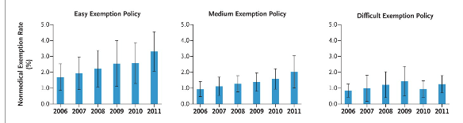
Ease of refusal can influence likelihood of refusal
Between 2009-12, none of the 31 bills introduced in 18 states to expand exemptions passed; 3 of 5 to restrict exemptions did pass
Omer SB, etal. NEJM 2012; 367; Omer SB JAMAPediatrics 2014;311(6).
Notes:
Significant variation within states (0-17%)

Slide 24
Vaccine hesitancy is a complex challenge that will require a multifaceted approach
Distrust and scientific denialism
Rapid dissemination of misinformation
Naturalism
Distortion of risk
Changes in Decision-making
Policy Approaches
Mandatory Vaccination Programs
Economic Incentives or Penalties
Social Restriction
Liability
Optimize Access
Reshape Social Norms
A strong consistent message is crucial

Slide 25
Layers of Vaccine Safety in US
Licensing authority
Academic investigators
Physician reports
Reports to companies
Reports to FDA (VAERS)
Vaccine safety data link studies
Centers for Disease Control safety department

Slide 26
Summary
Vaccine hesitancy is a worldwide problem owing
to the success of vaccines
And increasing independence of patients
However, it can be controlled by a variety of
measures if physicians and nurses are educated.

